Slide 1
Christ
in America
Other Sheep
Conquest Documents
Quetzalcoatl/Kulkulcan
God G1

Slide 2
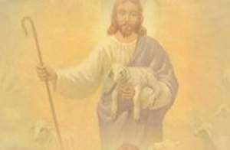
Jesus Said:
“And other sheep I have, which are not of this fold: them also I must bring, and they shall hear my voice; and there shall be one fold, and one shepherd.”
—John 10:16

Slide 3
“And other sheep I have, which are not of this fold; them also I must bring, and they shall hear my voice; and there shall be one fold, and one shepherd”.
John 10:16

Slide 4
“And verily, I say unto you, that ye are they of whom I said, Other sheep I have which are not of this fold; them also I must bring, and they shall hear my voice, and there shall be one fold”.
—3 Nephi:7:20

Slide 5
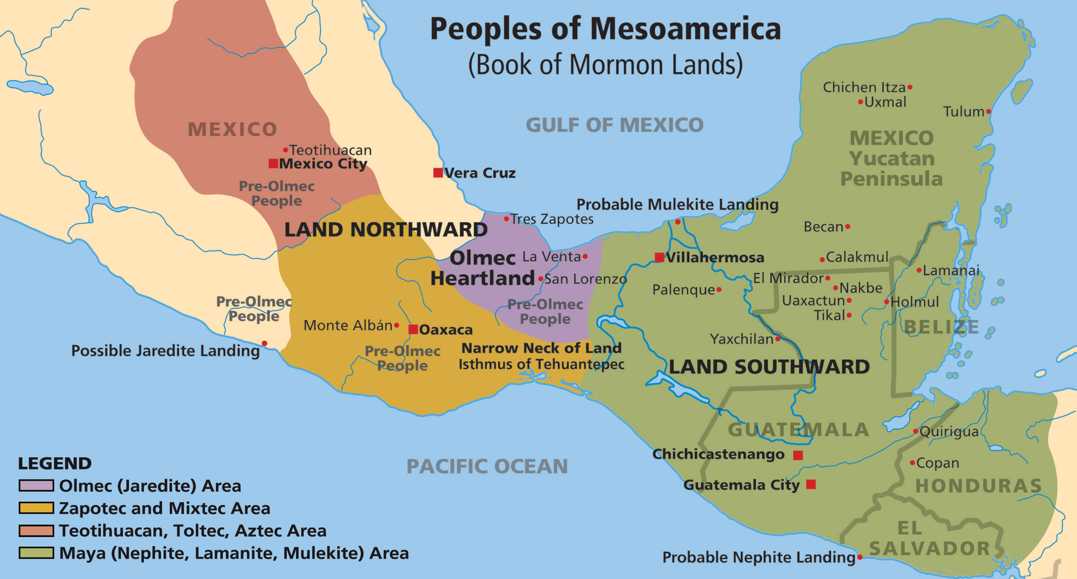

Slide 6
“A great multitude gathered together round about the temple . . . They cast their eyes up again towards heaven; and behold, they saw a man descending out of heaven. . .Behold I am Jesus Christ of whom the prophets testified should come into the world….”
—3 Nephi 5:1-11

Slide 7
Over the years many requests for information have been made, about the civilizations that once lived in the Americas. Many believers want to know how The Book of Mormon relates to Pre-Columbian people in the Americas.

Slide 8
Is there any evidence that Jesus Christ came to the Land of Promise, which we know as the Americas, as proclaimed in The Book of Mormon?
What shall we look for, and where shall we look?

Slide 9
I saw another angel flying
in the midst of heaven having the everlasting gospel to preach
unto them that dwell on the earth

Slide 12
To begin to answer the question, where did Book of Mormon people live in the Americas, there are three major questions to consider:
1. Where do we find a phonetic written language system?
2. Where does the archaeological record agree with Book of Mormon history?
3. Where are there major cultural similarities with The Book of Mormon account?

Slide 13
Only in one area of the Americas do we find answers and evidence to all three of these questions that match Book of Mormon history, culture and language. The area is what is known today by archaeologists as Mesoamerica.

Slide 15
BUT -- The Book of Mormon is NOT an account of people in North or South America. All history in The Book of Mormon, other than the journeys to come to the Land of Promise, is ONLY found in Mesoamerica. To believe otherwise simply defies the immense amount of evidence in Mesoamerica that converges with The Book of Mormon account of history, language, culture and geography.

Slide 16
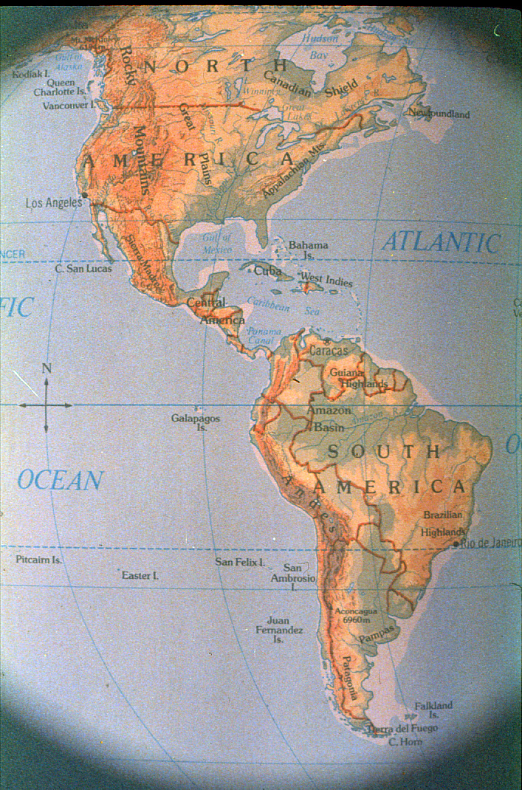
Notes:
But keep in mind that the BoM is not a history for North or South America.

Slide 17
Remember:
1. The Book of Mormon overwhelmingly points to a cultural area called Mesoamerica.
2. Radiocarbon dating was introduced in the 1950s bringing the civilizations in Mesoamerica in line with Book of Mormon dating.

Slide 18
3. In the 1980s, major breakthroughs occurred in the reading of the Maya hieroglyphs. Since the decipherment of about 90 percent of the glyphs, it has become apparent that the Maya employed the same literary patterns as found in The Book of Mormon.
Some of these literary patterns are frequent use of “it came to pass,” chiasms, couplets which are prevalent in the Psalms and word pairs.
Notes:
Some of these literary patterns are frequent use of “it came to pass,” chiasms, couplets witch are prevalent in the Psalms and word pairs.

Slide 19
4. In the last ten years, LIDAR imaging has proven Book of Mormon requirements for population numbers. Indeed the people were numerous “as the sands of the sea.”

Slide 21
The following archaeological references come from well known, current archaeologists. These are not my theories or ideas. These scholars tell the same account as found in The Book of Mormon even though they do not acknowledge it nor may not even realize it. The accepted study of archaeology is based on the theory of evolution and does not include belief in God and His dealings with mankind.

Slide 22
First, we will review some of the evidence from the conquest documents through the 19th century. Second, we will present considerable information about the hero god Quetzalcoatl/Kulkulkan.

Slide 23
Third, we will tie information on God GI with information from the conquest documents and Quetzalcoatl/Kulkulkan.
This information comes from Maya hieroglyphs that tells a unique story about a Maya god archaeologists call God GI. He is most often found in the Maya ruined city today called Palenque.

Slide 24
First, at the time of the Conquest:
The Spanish historian Garcia, when living in Mexico, was so impressed by the many points of resemblance between the Hebrews and the Mexicans, that he wrote a book in which he endeavored to prove that the inhabitants of tropical America were direct descendants of the lost tribes of Israel….
continued:

Slide 25
Nearly a century after Garcia’s time, another Spanish writer, Siguenza, who for many years had studied the ancient records, architecture, and the legends of Central America, came to the conclusion that “the Mexicans are descended from Hebrews who left Egypt and made a long journey to Mexico, after the confusion of tongues at Babel.
J.F. Lea, The Great Migration, 1933

Slide 26
The five letters of Cortez to the Emperor Charles V
“The identity of Quetzalcoatl remains an unsolved mystery. So numerous and striking were the analogies to Christian teachings presented by the Mexican beliefs and ritual, that the conviction has obtained amongst many, that this mysterious personage was no other than a Christian priest or bishop . . .
continued:

Slide 27
his teachings, his miracles, and his final disappearance, seem to be hopelessly interwoven with legends of other deities; his personality became merged in that of other mythical characters, with a plumed serpent for his emblem;
continued:

Slide 28
but there still remained a sufficient number of intelligible and authentic doctrines and practices traceable to him, to argue their Christian origin.”
NacNutt, Francis. A. The Five Letters of Cortez to the Emperor Charles V. 1908:342.
Notes:
The myth? Was so prevalent throughout Mexico that modern (1800s and 1900s) artists have depicted Quetzalcoatl in various ways.

Slide 29
Second, we will present considerable information about the hero god Quetzalcoatl/Kulkulkan.

Slide 30
Quetzalcoatl
Stained Glass Window in Palace of Cortez
in Cuernavaca

Slide 31
Notes:
Painting found in the National Palace in Mexico City.

Slide 32
Temple of the Bearded God Chichen Itza
Notes:
This depiction of Kulkulkan was carved, probably in the 10th century, at the site of Chichen Itza in the Yucatan of Mexico.
But NOW WE ARE GOING TO change from showing evidence from THE DOCUMENTS WRITTEN AT THE TIME OF THE CONQUEST AND SHOW CONSIDERABLE EVIDENCE ABOUT THE HERO GOD, QUETZAL/KULKULKAN.

Slide 33
“Both Mayas and Nahuas had . . . a consistent, meaningful, and cosmically complete mythological figure who was at once water, earth (in the crawling snake), and bird.”
Nicholson, Irene. Mexican and Central American Mythology. London: Paul Hamlyn, 1967:79-82

Slide 35
Notes:
Depiction of Quetzalcoatl found in the Art Museum in San Francisco.

Slide 36
Teotihuacan, Quetzalcoatl Pyramid
Notes:
At Teotihuacan close to Mexico City the rounded pyramid represents Quetzalcoatl.

Slide 37
Teotihuacan, Quetzalcoatl Pyramid
Notes:
Close up of some of the designs on the Temple of Quetzalcoatl close to Mexico City.

Slide 38
Teotihuacan, Quetzalcoatl Pyramid
Notes:
Three spheres of creation: Heaven (feathers for birds); serpent for earth; shells and other water symbols for sea.

Slide 39
“The Mayas had their equivalent of Quetzalcoatl, who was Kukulcan but the curious thing is that the word Quetzalcoatl, the Nahua name for the god, includes the symbolism of the quetzal bird which belongs to the Maya lands and is not found on the high plateau.”
Nicholson, Irene. Mexican and Central American Mythology. London: Paul Hamlyn, 1967:79-82

Slide 41
Quetzalcoatl (Nahuatl) Kukulcan (Maya)
Most powerful figure and dominant art motif
Cirlot, J. E. A Dictionary of Symbols. 2nd. Trans. From Spanish by Jack Sage. London: Routledge and Kegan Paul, 1962:289.

Slide 42
Quetzalcoatl (Nahuatl) Kukulcan (Maya)
Lord of creative forces
Breath of Life - Wind
Covarrubias, Miguel. Mexico South: The Isthmus of Tehuantepec. New York: Alfred A. Knopf, 1967: 130.

Slide 43
Quetzalcoatl (Nahuatl) Kukulcan (Maya)
Divine/Redeemer
Gives own life and blood
Nicholson, Irene. Mexican and Central American Mythology. London: Paul Hamlyn, 1967:96
Sejourne, Laurette. Burning Water. New York: Grove Press, 1960:69 & 71.
Weaver, Muriel Porter. The Aztecs, Maya, and Their Predecessors. New York: Seminar Press, 1972:205.

Slide 44
Quetzalcoatl (Nahuatl) Kukulcan (Maya)
Healer, performer of miracles
Nicholson, Irene. Mexican and Central American Mythology. London: Paul Hamlyn, 1967:96

Slide 45
Quetzalcoatl (Nahuatl) Kukulcan (Maya)
Born of a virgin
Nicholson, Irene. Mexican and Central American Mythology. London: Paul Hamlyn, 1967:985

Slide 46
Quetzalcoatl (Nahuatl) Kukulcan (Maya)
He comes down from heaven, lives on earth, descends to underworld to rise again.
Nicholson, Irene. Mexican and Central American Mythology, London: Paul Hamlyn, 1967:91 and
Sejourne, Laurette. Burning Water. New York: Grove Press, 1960:138.

Slide 47
Notes:
Painting of Quetzalcoatl in the National Palace in Mexico City.

Slide 48
Quetzalcoatl (Nahuatl) Kukulcan (Maya)
Double squared or stepped spirals, or scroll wing motif
Covarrubias, Miguel. Mexico South: The Isthmus of Tehuantepec. New York: Alfred A. Knopf, 1967: 130.

Slide 49
The symbol of the Feathered Serpent/Quetzalcoatl/Kulkulcan, the scrolled wing motif, is found in every city, one could almost say on every building. It is the predominate symbol of Mesoamerican religion in the ruins. Rather than looking for the cross, as we do in western Christianity, we need to look for the scrolled wing motif.

Slide 55
Quetzalcoatl Symbolism
“The plumed serpent must learn to fly. In other words, matter must transcend itself and be transmuted into pure spirit. But so equally must the quetzal bird descend into matter and join with the serpent to become part of the whole instinctive movement of organic life. In other words, spirit must enter matter to infuse it with life.”
Nicholson, Irene. Mexican and Central American Mythology. London: Paul Hamlyn, 1967:89

Slide 56
Physical Description
Quetzalcoatl “was tall, robust, broad of brow, with large eyes and a fair beard.”
“Laurette Sejourne believes that as a man he lived perhaps about the time of Christ….”
Nicholson, Irene. Mexican and Central American Mythology. London: Paul Hamlyn, 1967:83

Slide 58
We have checked out some of the conquest documents and also presented considerable information about the hero god Quetzalcoatl/Kulkulkan. All of this evidence would point to Christianity being in Mesoamerica before Columbus, but archaeologists for the past 100 years have believed that these documents were written by Indians who wanted to please their Spanish conquers, and therefore they did not write true history. So the conquests documents have not been believed.

Slide 59
Now with decipherment of the hieroglyphs we are beginning to see that the inscriptions, engraved in stone between 600 and 800 AD, tell the same story as the Conquest documents written in the 15th century.
Notes:
Most of the inscriptions carved on stone were carved in the 8th and 9th centuries.

Slide 60
Third, we will tie information on God GI with information from the conquest documents and Quetzalcoatl/Kulkulkan.
This information comes from Maya hieroglyphs that tells a unique story about a Maya god archaeologists call God GI. He is most often found in the Maya ruined city today called Palenque.

Slide 61
In 1963 when very few of the hieroglyphs could be read, Heinrich Berlin identified three major deities in the hieroglyphs at Palenque. He called them GI, GII, and GIII. As the name glyphs could not and still can not be read, the three gods are still referred to as GI, GII, and GIII. These are commonly called the Palenque Triad.
continued

Slide 62
Each of the Palenque Triad is associated with a group of three temples: GI with the Temple of the Cross (heaven), GII with the Temple of the Foliated Cross (sea), and GIII with the Temple of the Sun (earth).
Notes:
Only with the decipherment in the last few years has this become known.

Slide 64
Palenque – Cross Group of Temples, Sacred Space
Notes:
The Cross Group at Palenque, so called because of the cross motifs on the back wall panels of two of these buildings, is an architectural rendering of the three areas of creation: heaven, earth, sea. The lower building behind the tree is not a part of the group, it was built later.

Slide 65
Notes:
Closer side view of the Temple of the Cross, represents the heavens.

Slide 66
God GI -- Temple of the Cross Blue Band represents Heaven

Slide 67
God G2 – Temple of the Foliated Cross
Notes:
The whole front half of this temple has fallen off. One can see the large panel of inscriptions through the center doorway.

Slide 68
God GII - Temple of the Foliated Cross Blue Area Represents Sea

Slide 69
God GIII Temple of the Sun, represents earth

Slide 70
God GIII - Temple of the Sun Green Band Represents Earth

Slide 71
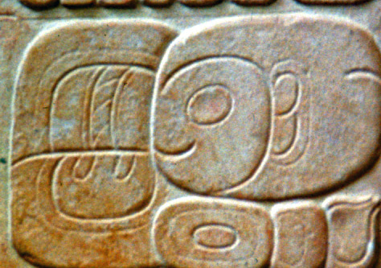
Great advancement has been made in the past 35 years and presently, scholars claim they can interpret about 95 percent of the inscriptions.
Notes:
Great strides have been made, though, within the last 35 years, in deciphering the Maya hieroglyphs. Presently, scholars claim they can interpret about 90 percent of the inscriptions.

Slide 72
Scholars such as David Stuart, Professor at the University of Texas, Austin, are beginning to say that God GI from Palenque, which is in the Maya area may also be Quetzalcoatl/Kulkulcan, who was the God up around what we now know as Mexico City.

Slide 73
Therefore, a closer look at new evidence about God GI is important. The evidence comes from the Temple of the Cross and Temple XIX at Palenque.

Slide 75
God GI Throughout Maya Area
“He is depicted and mentioned in numerous inscriptions and iconography throughout the Maya region from the beginnings of the Classic period, and he seems to have been a figure of major cosmological importance.”
Stuart, David. Inscriptions from Temple XIX at Palenque: A Commentary, 2005:163.

Slide 76
God GI and Quetzalcoatl
GI’s “birth” date was 9 Ik’ 15 Keh. Because 9 Ik or Nine Wind is associated with Ehecatl-Quetzalcoatl of central Mexico, a connection between the two may be possible.
Stuart, David. Inscriptions from Temple XIX at Palenque: A Commentary, 2005:168.

Slide 77
God GI and Quetzalcoatl
“It is difficult to draw close parallels between specific deities or supernatural characters in the Maya and Central Mexican religions, yet it seems entirely possible that GI and Ehecatl-Quetzalcoatl could both be reflections of an old idea or character from Preclassic mythology, and thereby share a common cultural origin.”
Stuart, David. Inscriptions from Temple XIX at Palenque: A Commentary, 2005:168.

Slide 78
The celestial Temple of the Cross is the “house” of GI, and thus his realm is the heavens.
David Stuart at the Maya Meetings,
University of Texas-Austin, 2006.

Slide 79
God GI
GI existed before he was born. His “birth” is described in the text in Palenque’s Tablet of the Cross and Temple XIX.
David Stuart, at the Maya Meetings, University of Texas-Austin, 2006.
Notes:
Stuart says, “The birth of GI, and perhaps those of his two lesser companions, can best be understood as re-births of already existing gods….” Stuart.

Slide 80
“God GI’s birth is the most confused, for he is named as both father . . . and son . . . On the Temple of the Cross….”
Miller and Taube, 1993:129-130

Slide 81
God GI
“Trying to explain how GI existed before he was born and how the other two are an integral part of GI is as hard to describe as the Christian belief in the Trinity.”
David Stuart, at the Maya Meetings, University of Texas-Austin, 2006.

Slide 82
God GI - Co-creator
Before his “birth” GI became a ruler “in the heavens” under the auspices of Itzamna a major deity in the heavens directing the creation.
David Stuart, at the Maya Meetings, University of Texas-Austin, 2006.

Slide 83
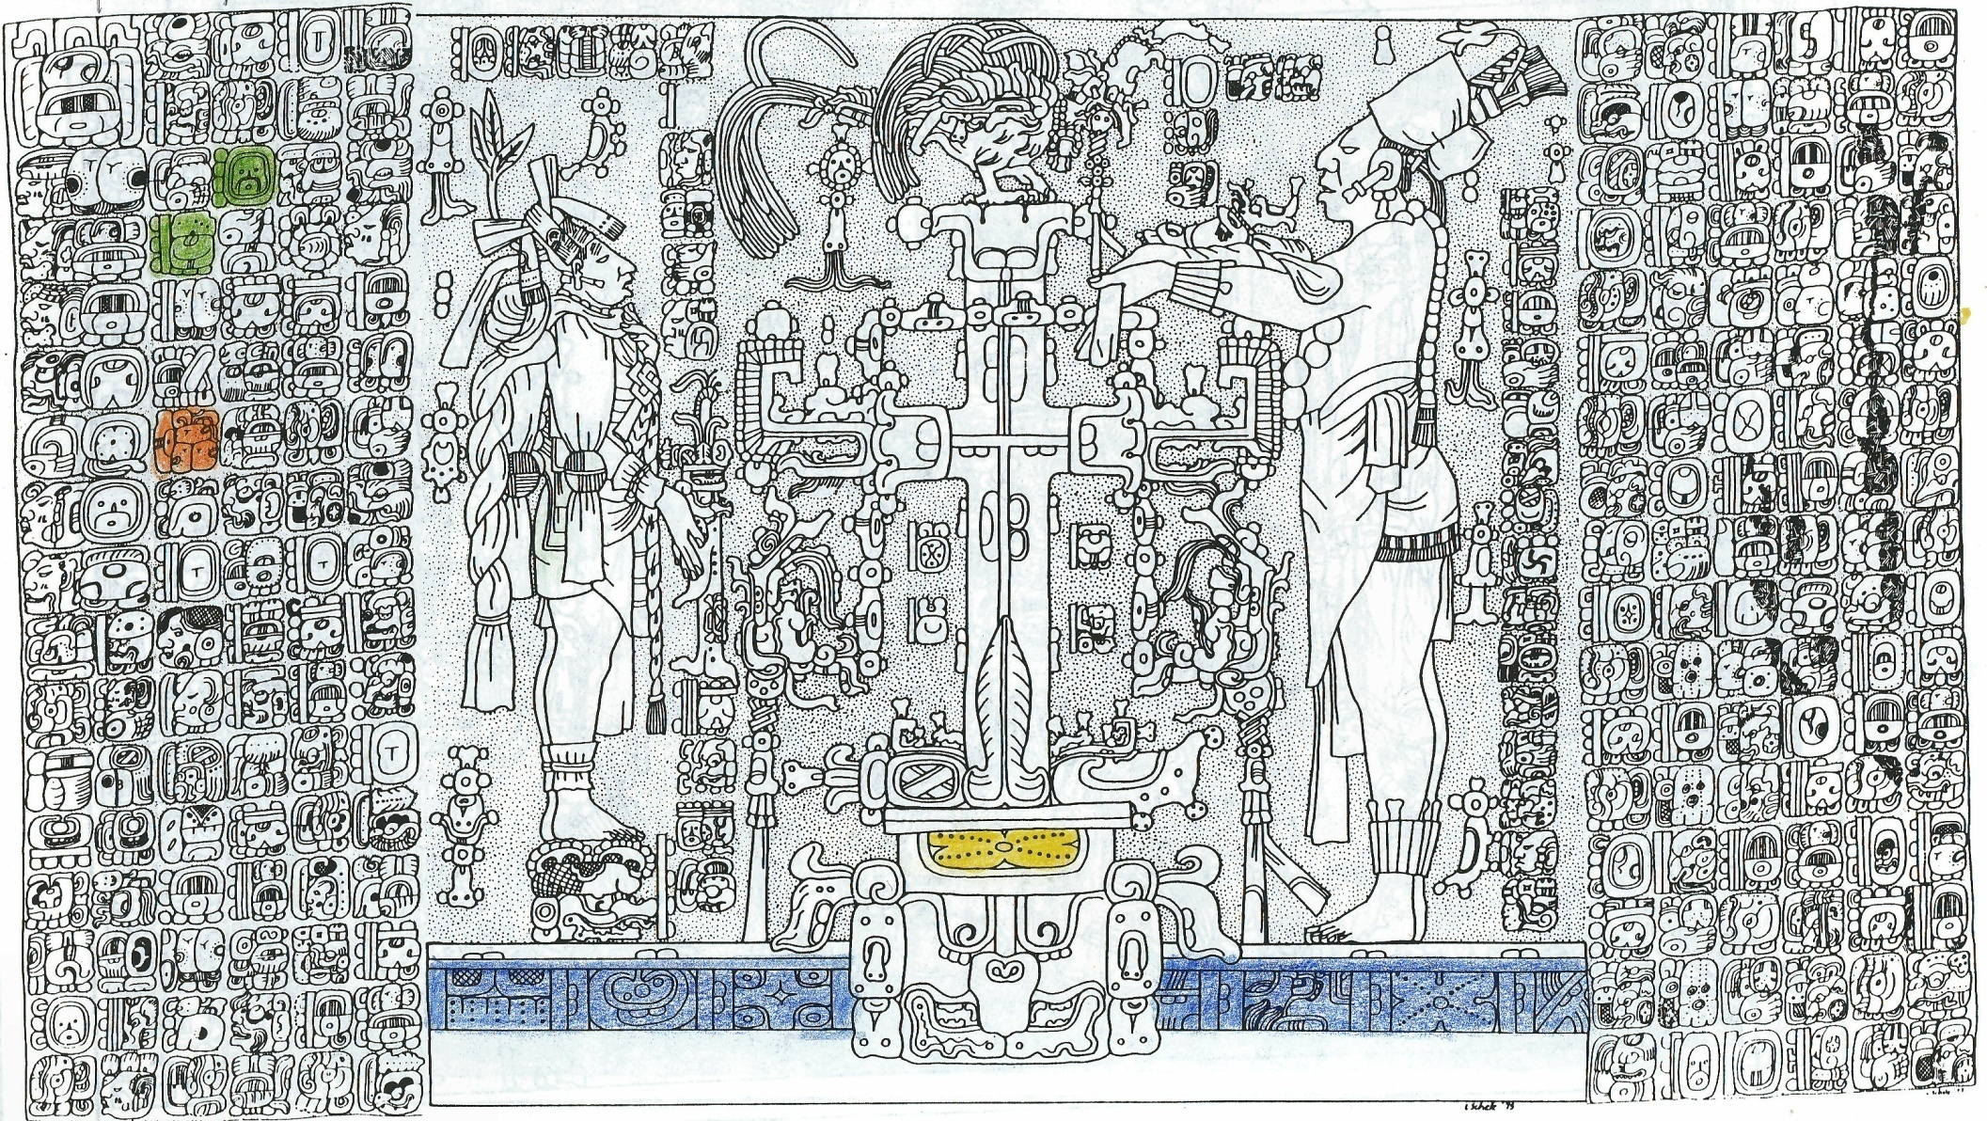
God GI Resurrection
The center motif on the back wall panel of a “tree-cross” emerging from the “solar bowl” is an important symbol for GI.
David Stuart, at the Maya Meetings, University of Texas-Austin, 2006.
Notes:
“Here the motif serves to reference that deity by highlighting his associations with the sun, the sky, and an overarching theme of ancestral resurrection.” Stuart 2006:116

Slide 85
God GI - Descends
A segment of the glyphs on the left portion of the Tablet of the Cross says that GI descends from the sky. After he descends, a temple is dedicated.
David Stuart, at the Maya Meetings, University of Texas-Austin, 2006.
Notes:
Christ appears to the Nephites near the temple in Land Bountiful after his resurrection and ascension into heaven. “They saw a man descending out of heaven. . .and he came down and stood in the midst of them…. He stretched forth his hand and spake unto the people, saying, Behold I am Jesus Christ, of whom the prophets testified should come into the world…. 3 Nephi 5:9-11.

Slide 86
“The ancient Itza-Maya practiced baptism, which means to be born again. They venerated one God and made no image of him. They worshiped toward the east and had confession of sins and atonement. They believed in Devils.”
Theodore Willard, The Lost Empires of the Itzaes and Maya, 1933

Slide 87
God GI - Sacrifice
GI seems to be a major participant in a sacrificial event.
David Stuart, at the Maya Meetings, University of Texas-Austin, 2006.
Notes:
And behold, this is the whole meaning of the law, every whit pointing to that great and last sacrifice; and that last and great sacrifice will be the son of God.” Alma 16:215

Slide 88
Palenque’s Temple XIX Bench
Notes:
This temple was only uncovered and restored within the last few years. This very long inscription corroborated and gave more light about the God GI.

Slide 90
God GI
Quetzalcoatl
Kulkulkan
Jesus Christ
Book of Mormon
Lord of Creation
Breath of Life/Wind
Divine/Redeemer
Gives own life/blood
Healer/performer of
miracles
God comes from heaven
lives on earth, descends
to underworld, rises
Lord of Creation
Holy Ghost/Spirit
Divine/Redeemer
Gives own life/blood
Healer/performer of
miracles
God comes from heaven,
visits the earth, descends
to underworld, rises

Slide 91
Yes, the stones and the conquest documents are
“crying out”
that Christ was in Mesoamerica.

Slide 92
Jesus Said:
“And other sheep I have, which are not of this fold: them also I must bring, and they shall hear my voice; and there shall be one fold, and one shepherd.”
—John 10:16

Slide 93
We began this presentation by showing evidence of documents from the conquest period through the 19th century.
Second we have presented considerable information about the hero god Quetzalcoatl known in the Maya area as Kulkulkan.
And finally we have shown current archaeological evidence that ties all three areas together in describing the Maya God GI.

Slide 94
Remember also that the study of archaeology is based on the theory of evolution, and does not accept the belief of God and creation. This means that most archaeologists will never see and understand the information presented here as supporting the belief that Christ was in Mesoamerica. Don’t expect them to!!
It is important for us to know that current archaeologists are telling the history as found in The Book of Mormon even though they do not understand it as doing so.

Slide 95
Keep in mind that Mesoamerica is the only area in the Americas where writing systems have been identified. While a few isolated examples of written inscriptions have been found in both North and South America, epigraphers recognize that the only writing systems in the Americas, earlier than Columbus, are found in Mesoamerica. The Book of Mormon absolutely requires a written language. Add to this the evidence that the writing system in the Maya area functions like old world scripts such as Egyptian.

Slide 96
I saw another angel flying in the midst of heaven having the everlasting gospel to preach unto unto them that dwell on the earth

Slide 97
The everlasting gospel is taught in The Book of Mormon, the Inspired Version of the Bible and the Doctrine and Covenants They witness of Jesus Christ

Slide 98
Underlining and coloring of words in this presentation has been done by the authors of this presentation to show emphasis.
This Power Point presentation is available for anyone to use. Please show it using “presenters mode.” That way you will have access to the notes that go with some of the pictures. If you have questions contact me.
Note also that it is under copy write. This means that if you change this material from what we have done you must let your viewers know what you have changed.
Lyle Smith
smith.lyle@usa.net

